Slide 1
Project Management within
Virtual Software Teams
Presented by Lauren Schoenheit

Slide 2


Slide 3
Software Development Teams
Co-site Software Team
- a group of individuals who are collocated and interdependent while actively collaborating on a common software/systems project.
Virtual Software Team
- a group of individuals operating across time, geographical locations, and organizational boundaries linked by communication technologies while actively collaborating on a common software/systems project.

Slide 4
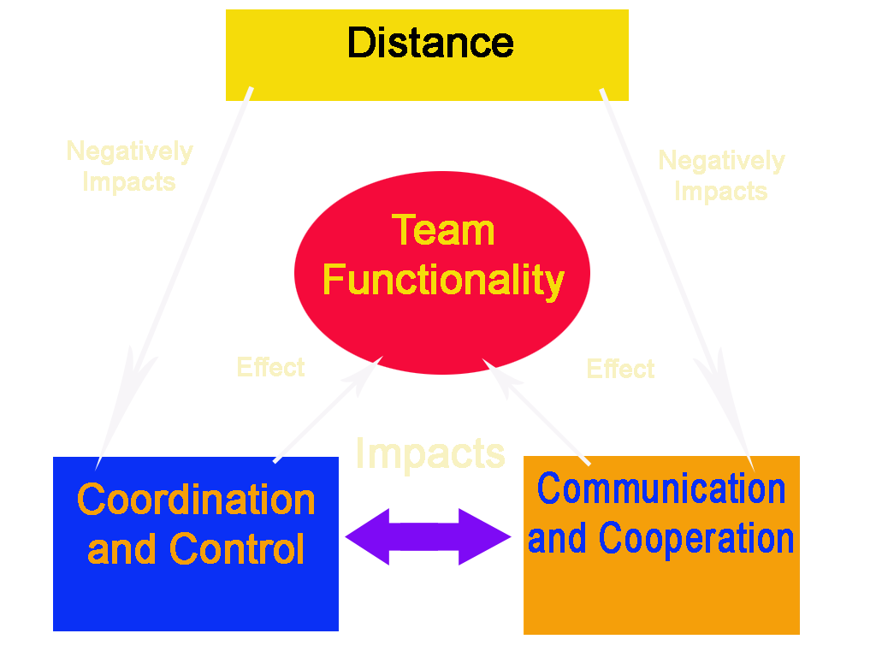
Impacts of Distance

Slide 5

Cultural Differences

Slide 6

Successful Virtual Software Teams
Travel
Communications Infrastructure
Standardize
Modularize
Build Trust
Address Cultural Differences

Slide 7
Conclusion
Outsourcing is a reality
Distance will affect a software team
Project management will determine whether the impact is positive or negative

